Slide 1

Active Directory: The good, The bad, and the lolWUT?
Defcon 31 Workshop

Slide 2
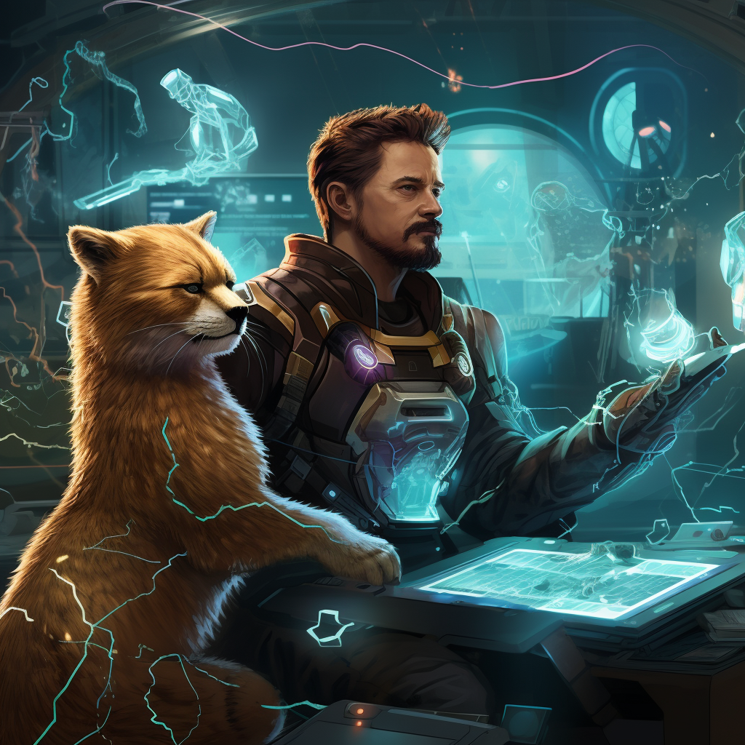

Aaron Rosenmund @arosenmund
In his quest for immortality, not for him, for his cat. He created the cybernetic mans best friend. Take that death. Every problem has at least one good solution, but just for him, not for you.
Long live ironcat.

Slide 3

Brandon DeVault @DeVaultsecurity
“Papa was a gambling man, always on the move” is the quote on Brandon’s grave stone. A funeral held without a body, but the old Brandon will never return. Making a deal to gain access to magic, it came with a cost, as we was transformed into a half man half cat. Embracing his love of cards and close up magic, he makes a quick buck off hustling tomcats at the tables by day, and works cyber magic by night to stay in touch with his humanity.

Slide 4
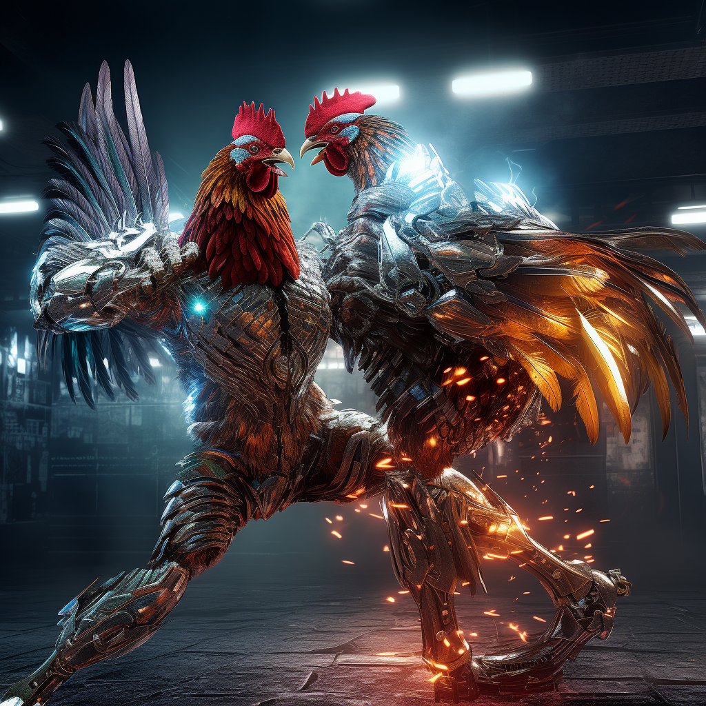
Ryan Chapman @rj_chap
While playing in an abandoned chicken processing factory as a child in Chile, Ryan very stereotypically fell into a vat of chemicals that forever changed him. Turning the ultimate set of lemons into lemonade, if lemonade was a cybernetically enhanced humanoid chicken, the doctors were able to enable him to have somewhat normal function by grafting his body with machines. Now known as the undefeated Mac Diablo in central America. He has carved out a stable life fighting in high stakes cockfighting games by day, and leveraging his enhanced connection to machines to hunt down cyber criminals by night.

Slide 5
Active Directory
Post Exploitation Tradecraft

Slide 6
Attack Flow
Common Threat Actor Techniques
Ransomware Actors
Detections for Common Techniques
Mitigations
Advanced Techniques and Defense Evasion
More Advanced techniques

Slide 7

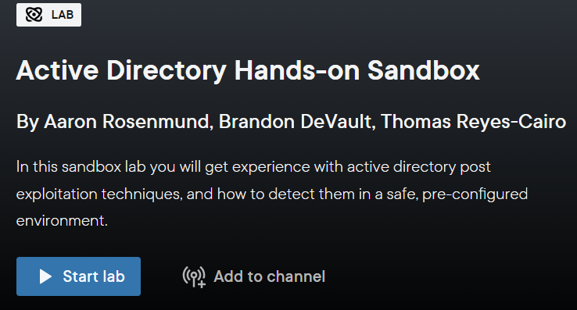
Account Required: www.pluralsight.com/free (no cc required)
Then, login and start the lab!
www.discord.gg/darkkittens
#Defcon31-active-directory

Slide 8
Active Directory Sandbox

Slide 9
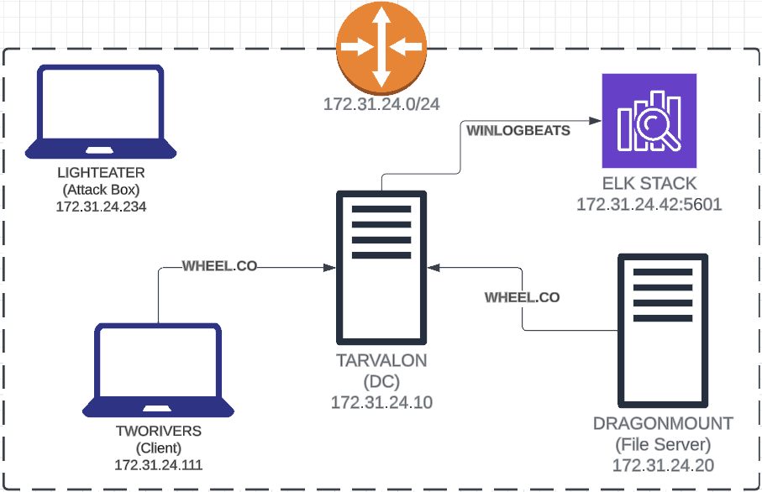

Slide 10
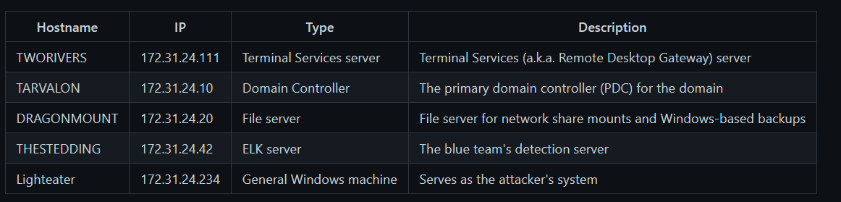

Slide 11
Credential Grabbing
Common Threat Actor Techniques
Mimikatz
Detections for Common Techniques
Powershell & Sysmon
Advanced Techniques and Defense Evasion
Custom tooling, Windows Defender Evasion

Slide 12
Detection: Cred Grabbing

Slide 13
Data Sources
Token Adjustment
Process Creation
Registry Changes

Slide 14
The Approach
Not dependent on EDR/Special Tools
PowerShell direct log queries
Can replicate in a production environment
Scalable to an enterprise
Easily transferrable to other tools / methods of detections

Slide 15
Me first! (Watch attentively)
Then your turn

Slide 16
Additional Notes – File System Analysis
Problems:
Variety of systems
Large Scale
Distributed Nature
Permission Issues
Security Considerations
Performance Impact
File Type Identification
Changes over time

Slide 17
Defensive Measures
MFA
Least Privilege
Auditing and review accounts and access
Protect Domain Admins
Implement Security Administrative Workstations (SAWs)

Slide 18
Advanced: Credential Grabbing

Slide 20
Enumeration
Common Threat Actor Techniques
Mimikatz
Detections for Common Techniques
Powershell & Sysmon
Advanced Techniques and Defense Evasion
Custom tooling, Windows Defender Evasion

Slide 21
Detection: Enumeration

Slide 22
Data Sources
More of the same (process creation and registry changes)
PowerShell Script Block Logging

Slide 23
What are IOCs?
Let’s go beyond the typical detections
IPs, hashes, filenames, blah blah….
Let’s take a look at a simple example

Slide 25
Defensive Measures
Least Privilege
Hardened Infrastructure

Slide 26
Advanced: Enumeration

Slide 28
Kerberoasting
Common Threat Actor Techniques
Mimikatz
Detections for Common Techniques
Powershell & Sysmon
Advanced Techniques and Defense Evasion
Custom tooling, Windows Defender Evasion

Slide 29
Detection: Kerberoasting

Slide 30
Data Sources
More of the same
Ticket Requests

Slide 31
Elasticsearch / SIEM
Centralized analysis
Pretty pictures
More effective queries at-scale

Slide 32
Defensive Measures
Strong Service Account Passwords
Kerberos AES Encryption
Use Managed Service Accounts (MSAs)
Reduce TGS Ticket Lifetime

Slide 33
Advanced: Kerberoasting

Slide 34
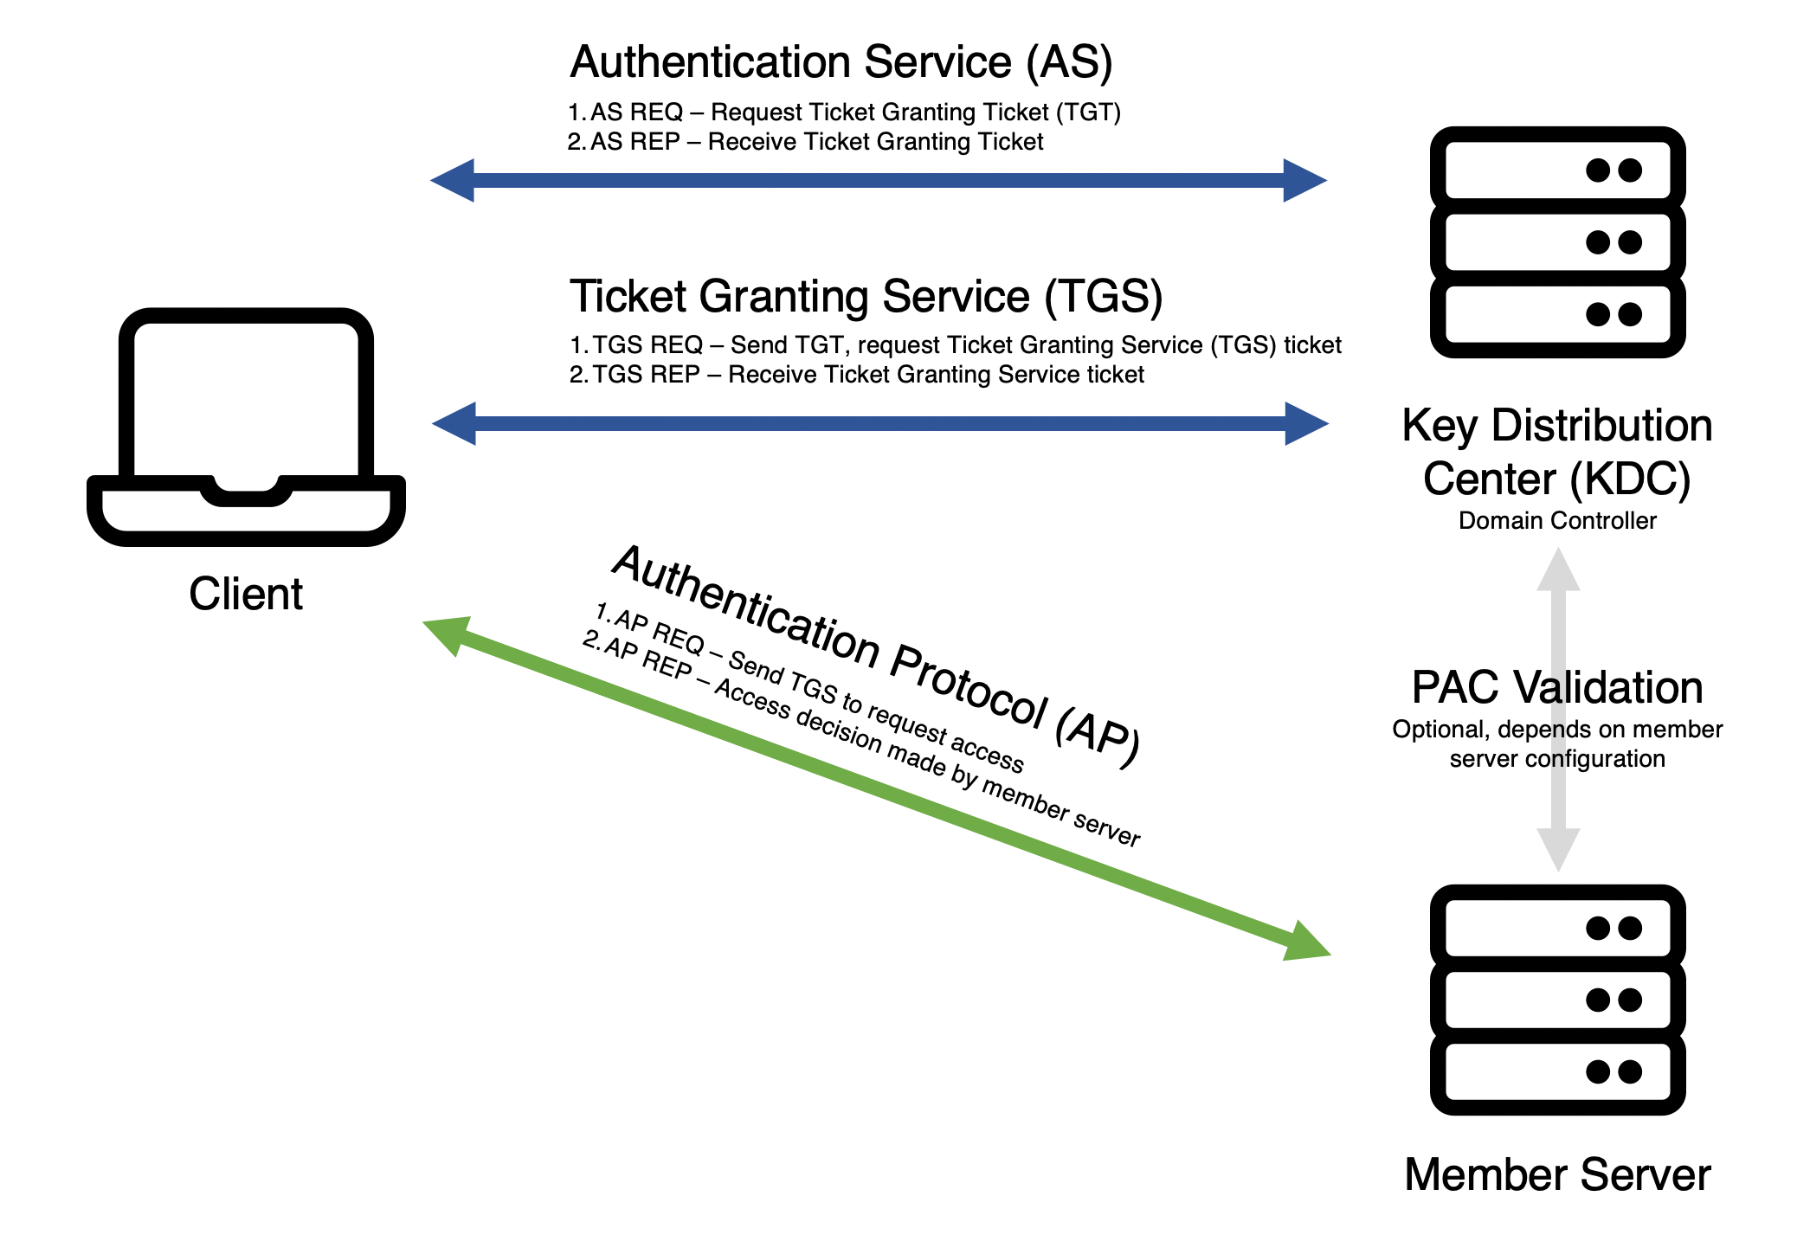

Slide 36
